Slide 1
WEEK 3
Marketing & Media Mix Modeling
and ROI Optimization
From $78M of spend to a reallocation you can defend in front of a CFO — with the uncertainty on the slide.
Andi Cupallari · Applied Data Science and AI in Pharma Commercial · Fall 2026 · Monday, September 28
Week 3 — Marketing Mix Modeling & ROI Optimization · Pharma DS&AI · Fall 2026
1 / 40
Notes:
Second coding night. One notebook (GLUCOREN, 156 weeks, five channels) run in two halves around the break. The thread from Weeks 1-2: the manufacturer sees a projected TRx series and its own spend; tonight it asks what the spend did. Homework 1 is released at the end and uses the same data.

Slide 2
AGENDA
Where we're going tonight
2.5 hours · one live notebook in two halves · one in-class exercise · Homework 1 released
0
Recap, mentors, and the Brand Lead's question
Which $10M would you cut? · three families of attribution — 15 min
1
The MMM equation
Adstock, Hill saturation, the response curve; average vs. marginal — 25 min
2
Fitting an OLS MMM — live, part 1
Controls (ramp, season, competitor, access) · grid search · diagnostics — 35 min
3
Decomposition, ROI and uncertainty — live, part 2
Base vs. incremental · ROI table · bootstrap and grid sensitivity · grading against the truth — 30 min
4
Calibration and Bayesian MMM
A DTC-TV geo holdout · priors · PyMC-Marketing in 12 lines — 15 min
5
Pitfalls and pharma realities
Five ways MMM lies · six pharma quirks · when MMM is the wrong tool — 10 min
6
In-class exercise, Homework 1, next week
Adstock by hand · reallocation by hand · pick the tool — 20 min
Week 3 — Marketing Mix Modeling & ROI Optimization · Pharma DS&AI · Fall 2026
2 / 40

Slide 3
00
Recap and the Brand Lead's question
Two weeks of 'what the manufacturer can see'. Tonight: what did its own spend do?
Week 3 — Marketing Mix Modeling & ROI Optimization · Pharma DS&AI · Fall 2026
3 / 40

Slide 4
0 · RECAP
Three things from Weeks 1–2 that tonight depends on
If any of these is fuzzy, say so now — the model inherits all three
1
The payer decides whether a script fills
2
TRx is projected, not counted
3
Contribution per TRx ≈ $250
▸ Week 1: chooser ≠ payer ≠ consumer. Formulary status moves TRx with zero spend change.
▸ Tonight it is a control variable — and the one most MMMs leave out.
▸ Week 2: the response variable is a stratified projection from a pharmacy panel, restated as the panel changes.
▸ Noise in y is fine for OLS; a restatement mid-series is not.
▸ Week 1's GLUCOREN P&L: net $274 per TRx, contribution $252.
▸ Tonight's ROI uses a $250 placeholder. Finance owns this number; never invent it in a real engagement.
Mentor check: every team should have met its mentor by tonight. Problem statement + data plan due Monday, October 5 (one page, Week 2 template).
Week 3 — Marketing Mix Modeling & ROI Optimization · Pharma DS&AI · Fall 2026
4 / 40
Notes:
Ask for a show of hands on mentor meetings. Then bridge: Week 2 ended with 'does a rep visit change prescribing?' — tonight is that question, at brand level, for five channels.

Slide 5
0 · THE QUESTION
The Brand Lead's question — asked at every quarterly business review
GLUCOREN, three years after launch
“We have spent $78M promoting GLUCOREN since launch — about $26M a year across reps, conferences, digital, email and TV.
Which $10M would you cut? And how sure are you?”
What we owe back
What we will not pretend
▸ A decomposition: how much TRx the brand generated on its own vs. from each channel
▸ ROI per channel — average (what we got) and marginal (what the next dollar gets)
▸ A reallocation with a stated risk posture, and the range around every number
▸ The list of what the model is not capturing, and the experiment that would settle it
▸ That a regression on 156 weekly rows is a causal experiment
▸ That an ROI to two decimal places means anything
▸ That the model can forecast a formulary change it has never seen
▸ That the highest-ROI channel is the one to grow (it usually is not)
Week 3 — Marketing Mix Modeling & ROI Optimization · Pharma DS&AI · Fall 2026
5 / 40

Slide 6
0 · THREE FAMILIES
Three ways to attribute sales to marketing — pick on purpose
Tonight is MMM. The right answer in industry is 'all three, calibrating each other'.
 | Marketing Mix Modeling (MMM) | Multi-touch attribution (MTA) | Incrementality experiments
What it is | Top-down regression of weekly (or geo-weekly) outcomes on transformed spend + controls | Person-level, journey-based credit for digital touchpoints | Geo holdouts, matched DMAs, switchbacks, conversion-lift tests
Sees | Every channel incl. offline: reps, conferences, TV, samples; the system (base, season, competitor) | Only what is tracked: web, email, banners, search — one identity graph | One channel (or one change) at a time, cleanly
Blind to | Day-level tactics; person-level; anything that never varied in the data | Offline entirely; increasingly broken by privacy and cookie deprecation; no HCP-level consent in pharma | Everything not tested; slow; costs real revenue in dark cells
Data needed | 2+ years weekly; spend by channel; controls (access, competitor) | Person-level event logs with a stable ID | Randomizable units (DMAs, territories, HCP lists) and patience
Pharma fit | The standard tool for annual planning and the QBR | Limited: HCP digital only; patient-level MTA is off-limits | Field-force experiments are old (territory holdouts); DTC geo tests are common
Week 3 — Marketing Mix Modeling & ROI Optimization · Pharma DS&AI · Fall 2026
6 / 40
Notes:
Interview question: 'why not just use last-click attribution?' Because nothing a rep does has a click. And because the payer sits between the touch and the fill.

Slide 7
01
The MMM equation
Two transforms — carryover and saturation — turn spend into something a regression can see.
Week 3 — Marketing Mix Modeling & ROI Optimization · Pharma DS&AI · Fall 2026
7 / 40

Slide 8
1 · THE EQUATION
What we are actually fitting
Read it left to right; every term is a decision you will have to defend
TRx_t = β₀ + Σ_c β_c · Hill( Adstock( x_c,t ; δ_c ) ; K_c , s_c ) + γ · ramp_t + η₁ sin_t + η₂ cos_t + λ · competitor_t + φ · access_t + ε_t
Term | Meaning | Estimated how | If you leave it out
β₀ + γ·ramp | The base: what the brand does on its own (launch ramp, awareness, refills accumulating) | OLS (ramp midpoint and scale on a grid) | Channels that grew with the brand steal the ramp
Adstock(x; δ) | Carryover: this week's spend works for weeks. δ = share carried to next week | Grid or prior — non-linear | Everything looks like same-week response; ROI understated for slow channels
Hill(a; K, s) | Saturation: K = half-saturation point, s = shape (S-curve if s > 1) | Grid or prior — non-linear | Linear response → marginal = average → the optimizer pours money into one channel
β_c | Maximum weekly TRx the channel can deliver (Hill tops out at 1) | OLS, given the transforms | —
season, competitor, access | What moves TRx and is not promotion | OLS | A channel absorbs the effect (tonight: the formulary win)
ε | Everything else. Structure in here = something missing | Residual diagnostics | You ship a wrong model
Week 3 — Marketing Mix Modeling & ROI Optimization · Pharma DS&AI · Fall 2026
8 / 40

Slide 9
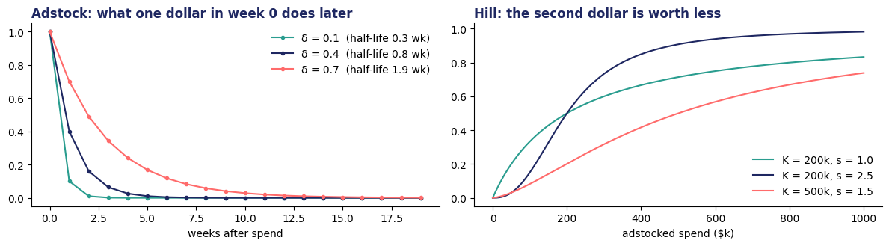
1 · ADSTOCK
Adstock — spend echoes through time
Geometric form: a_t = x_t + δ · a_{t−1}. Half-life = ln 0.5 / ln δ.
Typical δ by channel (weekly data)
▸ 0.6–0.8: TV, sponsorships, KOL programs — slow build, long tail
▸ 0.3–0.6: HCP detailing, conferences — a rep visit works for a month or two
▸ 0.0–0.25: email, paid search, banners — gone by next week
Two variants you will meet
▸ Weibull adstock: lets the peak land after week 0 (a detail → next eligible patient → script → fill lag of 4–8 weeks)
▸ l_max: PyMC-Marketing truncates the tail at l_max weeks; 8–12 is typical
Week 3 — Marketing Mix Modeling & ROI Optimization · Pharma DS&AI · Fall 2026
9 / 40
Notes:
Left panel is from tonight's notebook. Ask: why would a rep visit have a longer half-life than an email? Because the physician has to wait for the next eligible patient.

Slide 10
1 · SATURATION
Hill saturation — the second dollar is worth less than the first
h(a) = aˢ / (aˢ + Kˢ). K is where the channel is at half its maximum; s > 1 gives a threshold before it works.
K — half-saturation point
s — shape
▸ Spend (adstocked) at which the channel delivers 50% of its maximum
▸ Small K relative to spend = the channel is saturated: more money does little
▸ Tonight K is searched as a multiple of the channel's median adstocked spend
▸ s = 1: concave from the first dollar (diminishing returns immediately)
▸ s > 1: S-shaped — a frequency floor before the channel converts (one TV impression does nothing; ten might)
▸ s also decides how sharp the marginal ROI falls beyond K
The response curve — adstock decides when, saturation decides how much
▸ Average ROI = total response ÷ total spend — the area under the curve so far. A reporting number.
▸ Marginal ROI = the slope of the curve at current spend — what the next dollar returns. A decision number.
▸ Saturation guarantees they rank channels differently. A saturated channel can have the best average and the worst marginal.
Week 3 — Marketing Mix Modeling & ROI Optimization · Pharma DS&AI · Fall 2026
10 / 40

Slide 11
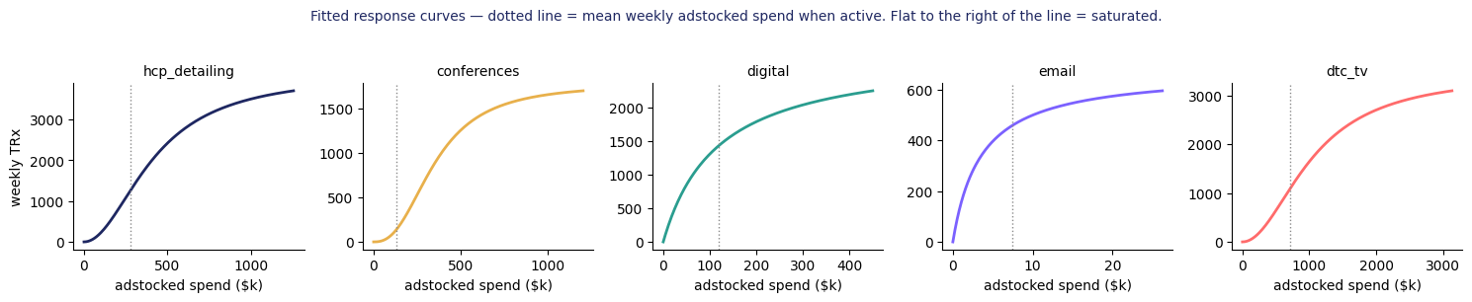
1 · AVERAGE VS. MARGINAL
The one distinction that decides whether your recommendation is right
Tonight's fitted curves — dotted line = mean weekly adstocked spend when the channel is active
Email sits far to the right of its K: the best average ROI in the brand and almost nothing left to gain. Digital and detailing sit on the steep part. DTC TV is on the flat top of an S-curve with the biggest budget.
Reporting → average. Decisions → marginal. Confusing them in front of leadership produces confidently wrong reallocations — and it is the most common MMM error we see in QBR decks.
Week 3 — Marketing Mix Modeling & ROI Optimization · Pharma DS&AI · Fall 2026
11 / 40
Notes:
This slide is the hinge of the night. If students remember one thing, it is this one.

Slide 12
02
Fitting an OLS MMM — live
Part 1 of the notebook: controls, the grid, diagnostics. The fastest defensible model — if you respect the diagnostics.
Week 3 — Marketing Mix Modeling & ROI Optimization · Pharma DS&AI · Fall 2026
12 / 40

Slide 13
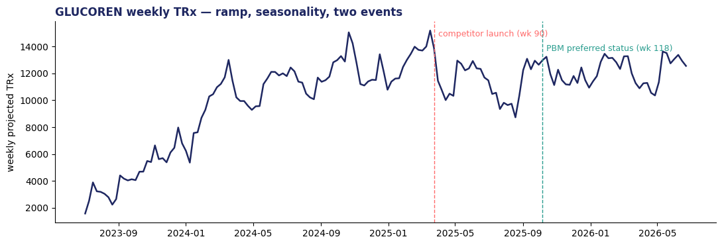
2 · THE DATA
GLUCOREN: 156 weeks, five channels, two events, one placeholder
glucoren_weekly_mmm.csv — projected national TRx and weekly spend; synthetic, from a known response model
Column | What it is
trx | Weekly projected national TRx (Week 2's panel projection)
*_spend (5) | Weekly $ by channel: detailing, conferences, digital, email, DTC TV
hcp_calls | Rep calls delivered — an alternative 'dose' for detailing
competitor_active | 0/1 from week 90 (a competitor launched)
pbm_preferred_share | Share of commercial lives with preferred status; steps 0.38 → 0.61 at week 118
$78M
$26M / yr
1.62M
spend over the launch period
35% TV · 34% detailing · 18% digital · 12% conferences · 1% email
TRx over 156 weeks
Detailing is steady, conferences are spikes, TV runs in 8-week flights, digital pulses and co-moves with TV, email is tiny. Each pattern is a different identification problem.
Week 3 — Marketing Mix Modeling & ROI Optimization · Pharma DS&AI · Fall 2026
13 / 40

Slide 14
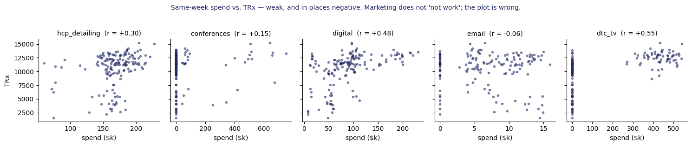
2 · WHY NAIVE FAILS
Same-week spend vs. TRx: weak, and for detailing negative
Marketing does not 'not work'. The plot is wrong: carryover, saturation and the launch ramp are all missing.
Detailing was trimmed in year 3 while TRx kept rising on its base and on the formulary win — so a same-week scatter says reps hurt sales. Every brand team has seen a slide like this presented as evidence.
The fix is not a smarter scatter. It is the model on slide 8: transform the spend, control for what is not promotion, then read the coefficients.
Week 3 — Marketing Mix Modeling & ROI Optimization · Pharma DS&AI · Fall 2026
14 / 40

Slide 15
2 · CONTROLS
In pharma, the controls are the model
Everything that moves TRx and is not promotion must be in the regression — or a channel will take the credit
Control | Tonight's feature | Why it is there | What happens if you leave it out (from the notebook)
Launch ramp | Logistic in t; midpoint and scale searched by AIC (media-blind fit is biased upward by early marketing) | New brands grow on their own: awareness, formulary wins, refills accumulating | Channels that grew with the brand (digital) become the ramp
Seasonality | Annual sine + cosine | Deductible resets, refill timing, flu season in some categories | A channel that spends in Q1 gets the January bump
Competitor launch | 0/1 from week 90 | Share loss that has nothing to do with our spend | The channels cut after the launch look ineffective
Formulary access | Share of lives with preferred status (0.38 → 0.61 at week 118) | Week 1: the payer decides whether the script fills | Competitor coefficient halves; detailing loses 18% of its credit; AIC worse by 79
Not modeled tonight | Copay program, samples, price changes, MLR content cycles, panel restatements | Each is a real driver; name them in the memo | They land in the residual — inspect it
Week 3 — Marketing Mix Modeling & ROI Optimization · Pharma DS&AI · Fall 2026
15 / 40
Notes:
The formulary row is the pharma-specific lesson: access data is usually NOT in the MMM dataset the agency hands you. You have to go and get it (Week 2's category 4).

Slide 16
2 · THE RECIPE
The OLS recipe — six steps, in order
The order matters: controls before channels, diagnostics before decomposition, decomposition before ROI
1
Engineer the controls
2
Bound the grid with knowledge
3
Search, one channel at a time
Ramp, season, competitor, access. Fit the ramp media-blind first, then let AIC refine it.
δ ranges per channel (TV 0.4–0.7, email ≤ 0.25) — the OLS analogue of a prior. K as a multiple of median adstocked spend; s ∈ {1 … 2.5}.
Coordinate descent on AIC, two or three sweeps; ramp parameters in between. ~1,000 OLS fits, seconds.
4
Diagnose
5
Decompose
6
ROI with ranges
Residuals (Durbin–Watson), VIF, signs, hold-out MAPE. Fix the data or the controls; never keep a negative media coefficient.
β_c × Hill(Adstock) per week, stacked on the base. This is the chart leadership wants.
Average and marginal per channel; block-bootstrap the coefficients; re-run the runner-up grid cells; then reallocate.
Week 3 — Marketing Mix Modeling & ROI Optimization · Pharma DS&AI · Fall 2026
16 / 40

Slide 17
2 · HYPERPARAMETERS
Where δ, K and s come from — grid search now, priors later
They are non-linear in the loss; OLS cannot solve them. Two honest ways to get them.
Grid search (tonight)
Bayesian priors (section 4)
▸ How: for each channel, try every (δ, K, s) on a coarse grid with the other channels fixed; keep the AIC-minimizing cell; sweep again.
▸ Pros: fast, transparent, easy to explain to a brand team; no sampler to debug.
▸ Cons: no uncertainty on the winner; neighbouring cells within 2 AIC are indistinguishable and can imply different ROI (notebook §5c: detailing δ 0.40 vs 0.25, ROI 1.88 vs 1.76).
▸ Rule: bound the grid with channel knowledge; report the runner-up cells.
▸ How: Beta(2,2) on δ, log-normal on K, gamma on s, half-normal on β; MCMC gives posteriors on everything, including ROI.
▸ Pros: credible intervals for free; priors can encode a geo-lift result or last year's model; answers 'P(ROI_A > ROI_B)' directly.
▸ Cons: minutes of sampling, harder to debug, and priors you must be able to defend in a room.
▸ Practice: OLS for v1 ('is there a signal?'), Bayesian for v2 ('how sure, and what should we do?').
Tonight's winners: detailing δ 0.40 · K 1.5× · s 2.0 | conferences 0.55 · 8× · 2.5 | digital 0.25 · 1× · 1.0 | email 0.10 · 0.5× · 1.0 | DTC TV 0.70 · 1.5× · 2.0. The generating model used δ = 0.55 / 0.35 / 0.25 / 0.10 / 0.65.
Week 3 — Marketing Mix Modeling & ROI Optimization · Pharma DS&AI · Fall 2026
17 / 40

Slide 18
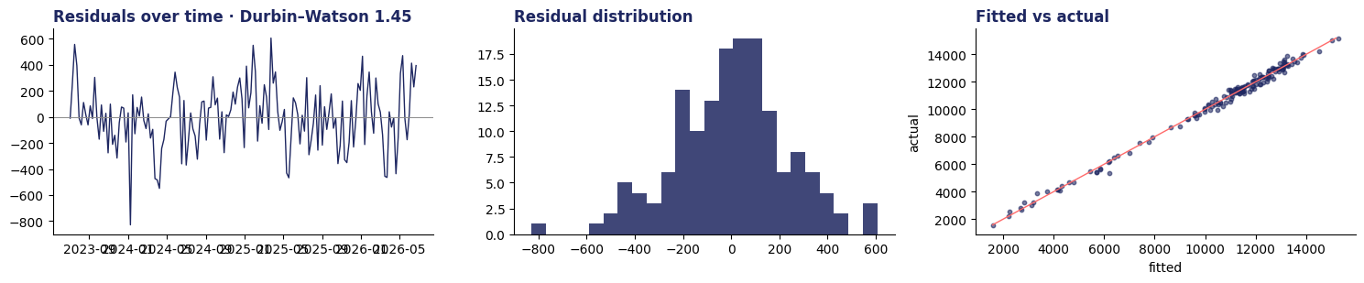
2 · DIAGNOSTICS
Diagnostics — what stops you from shipping a wrong model
From the notebook: R² 0.994 · Durbin–Watson 1.45 (mild positive autocorrelation — the ramped competitor effect is modeled as a step) · every VIF < 2.6 · hold-out MAPE 4.9%
Residuals
VIF
Signs
Hold-out
▸ White noise around zero. A slow wave = a missing control; autocorrelation (DW far from 2) = a missing trend or wrong δ.
▸ < 5 fine · 5–10 suspicious · > 10 not separately identified. Co-spend (digital with TV) and ramp-like channels are the usual causes.
▸ Every media β positive. A negative detailing β is a confounder, not a finding — fix the controls, do not report it.
▸ Train on 104 weeks, predict 52: MAPE 1.6% before the formulary step, 6.1% after. The model cannot forecast an event it never saw.
Week 3 — Marketing Mix Modeling & ROI Optimization · Pharma DS&AI · Fall 2026
18 / 40

Slide 19
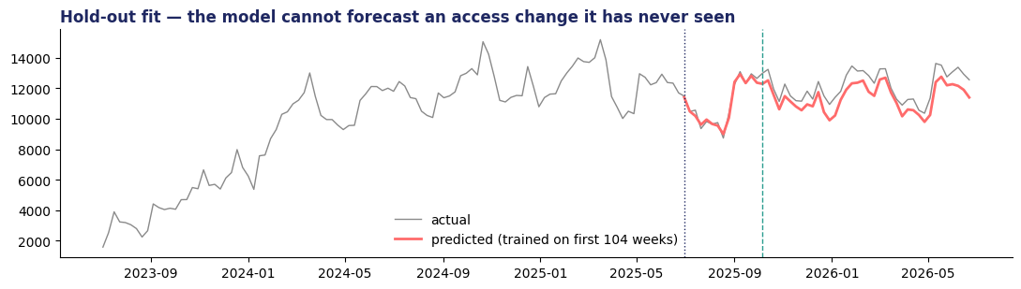
2 · HOLD-OUT
The hold-out shows what an MMM is for — and what it is not for
Coefficients trained on weeks 1–104; the formulary win lands at week 118, inside the test window
Two caveats for the homework
▸ 1. This hold-out tests the coefficients, not the grid: δ, K, s were chosen on all 156 weeks. The strict version re-runs the grid on the training window.
▸ 2. An MMM explains the past. It does not forecast an access change, a recall or a label event it has never seen. Forecasting is Week 6; interrupted time series is the tool for one-off events.
▸ Rule: state both in the memo. A reviewer who finds them first stops reading.
Week 3 — Marketing Mix Modeling & ROI Optimization · Pharma DS&AI · Fall 2026
19 / 40

Slide 20
03
Decomposition, ROI and uncertainty — live
Part 2 of the notebook: the chart leadership wants, the table they will argue about, and the ranges that keep you honest.
Week 3 — Marketing Mix Modeling & ROI Optimization · Pharma DS&AI · Fall 2026
20 / 40

Slide 21
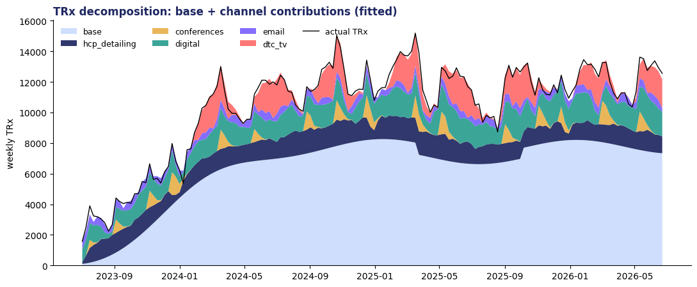
3 · DECOMPOSITION
Base vs. incremental — show this before any ROI number
Of 1.62M TRx: 61% base · 12% detailing · 13% digital · 8% DTC TV · 4% email · 2% conferences
How to read it
▸ Base = intercept + ramp + season + competitor + access. It is the brand's own momentum — and the payer's decisions.
▸ Each band is β_c × Hill(Adstock) for that week. TV shows up as flights; conferences as spikes that decay.
▸ Black line = actual. Gap = residual. Here the fit is tight; in real data expect 3–6% unexplained.
▸ The generating model's base share was 60.7%. We recovered 60.8%.
Week 3 — Marketing Mix Modeling & ROI Optimization · Pharma DS&AI · Fall 2026
21 / 40
Notes:
Point at the dip at week 90 (competitor) and the step at week 118 (formulary) inside the base band. Leadership will ask 'what is base?' — the answer is 'what you would have sold with zero promotion this week, given access and the competitor'.

Slide 22
3 · ROI TABLE
ROI per channel — average vs. marginal, and the truth we happen to know
Contribution at $250 per TRx. Marginal = +5% spend in every week of that channel, model re-evaluated.
Channel | Spend $M | Incremental TRx | Avg ROI (fitted) | Avg ROI (truth) | Marginal ROI (fitted) | Marginal (truth) | Rank avg → marginal
Email | 1.0 | 61k | 14.7 | 11.1 | 4.6 | 3.7 | 1 → 1
Digital | 14.1 | 208k | 3.70 | 3.58 | 1.76 | 1.85 | 2 → 3
HCP detailing | 26.1 | 196k | 1.88 | 2.09 | 2.55 | 1.61 | 3 → 2
DTC TV | 27.6 | 133k | 1.21 | 1.28 | 1.18 | 1.04 | 4 → 5
Conferences | 9.1 | 40k | 1.09 | 1.00 | 1.19 | 0.80 | 5 → 4
What this brand teaches
Where the method missed
▸ Email: best ROI, $1M budget, saturated — the answer to 'so put $5M into email?' is an ROI of 1.4 on that $5M (notebook §11)
▸ TV: 35% of the budget at the lowest marginal return — cut, do not kill (the geo test says it works)
▸ Detailing's marginal is over-stated (fitted s = 2.0 vs. true 1.3): steady spend gives the curve little to learn from
▸ Conferences: episodic spend — compute ROI by event, not weekly average
Week 3 — Marketing Mix Modeling & ROI Optimization · Pharma DS&AI · Fall 2026
22 / 40
Notes:
The 'truth' columns exist only because the data is synthetic. In a real engagement you never see them — which is why the next three slides exist.

Slide 23
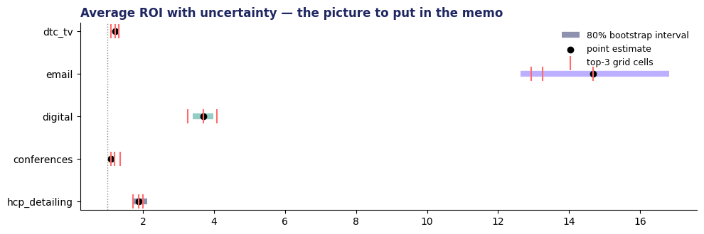
3 · UNCERTAINTY
Ranges, not points — the picture that belongs in the memo
80% moving-block bootstrap intervals (300 refits, 8-week blocks) plus the ROI implied by the three best grid cells per channel
Two sources, two tools
▸ Sampling error: bootstrap the residuals in blocks (keeps autocorrelation), refit, read percentiles. Narrow here because the fit is tight.
▸ Specification error: neighbouring grid cells (ΔAIC < 2) imply different ROI — the coral ticks. Wider than the bootstrap for detailing.
▸ Neither captures a missing control. Only a design change — or an experiment — does that.
Report 'digital 3.4–4.0' rather than '3.70'. It lands better with a CFO, and it is more honest.
Week 3 — Marketing Mix Modeling & ROI Optimization · Pharma DS&AI · Fall 2026
23 / 40

Slide 24
3 · GRADING
Grading against the truth: the ranking is right, the levels are ±10–30%, the decay is within a grid step
Synthetic data lets us do what a real engagement never can. The point is to see how the method misses.
Channel | Fitted TRx | True TRx | Error | Fitted δ / s | True δ / s | Why
HCP detailing | 196k | 218k | −10% | 0.40 / 2.0 | 0.55 / 1.3 | Steady spend: the curve's shape is barely identified; the S-curve over-states the marginal
Conferences | 40k | 36k | +9% | 0.55 / 2.5 | 0.35 / 1.8 | Spikes identify β well; the tail is confounded with the following weeks' detailing
Digital | 208k | 202k | +3% | 0.25 / 1.0 | 0.25 / 1.0 | Pulses and dark windows give the grid what it needs
Email | 61k | 46k | +33% | 0.10 / 1.0 | 0.10 / 1.5 | Tiny channel; wide interval; a saturated channel looks like the intercept
DTC TV | 133k | 141k | −6% | 0.70 / 2.0 | 0.65 / 1.6 | Flights on/off are the ideal identification pattern
The pattern generalises: channels that vary (flights, pulses) are measurable; channels that never vary (an always-on field force) are not — however big. Variation in spend is the price of measurement. That is the argument for planned experiments.
Week 3 — Marketing Mix Modeling & ROI Optimization · Pharma DS&AI · Fall 2026
24 / 40

Slide 25
04
Calibration and Bayesian MMM
Models without calibration are confident lies. One clean experiment per major channel per year beats a fancier model.
Week 3 — Marketing Mix Modeling & ROI Optimization · Pharma DS&AI · Fall 2026
25 / 40

Slide 26
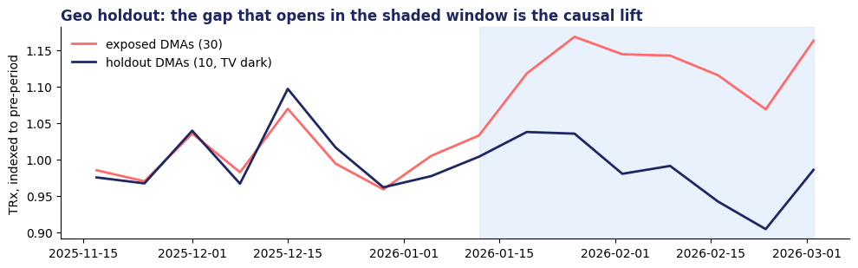
4 · GEO HOLDOUT
The DTC-TV geo holdout: flight 7 dark in 10 of 40 DMAs
Difference-in-differences on the DMA panel: 8 pre-weeks, 8 test weeks. glucoren_geo_lift_dtc_tv.csv
 | Pre (8 wk) | Test (8 wk) | Growth
Exposed (30 DMAs) | 74,139 | 82,959 | 1.119
Holdout (10 DMAs) | 17,719 | 17,453 | 0.985
Result
▸ Lift = 82,959 − 74,139 × 0.985 = 9,933 TRx (13.6%) in exposed DMAs
▸ TV spend in those DMAs: $2.36M → experiment ROI 1.05
▸ MMM's view of the same flight and DMAs: 0.97. Truth: 1.08.
▸ Agreement inside the interval → the TV coefficient is credible. Disagreement → the experiment wins; it has the cleaner identification.
What could make the difference-in-differences wrong
▸ Spillover: TV signal leaks across DMA borders (holdout is partly exposed → lift understated)
▸ Non-parallel trends: the ten dark DMAs were already growing differently (check the pre-period)
▸ Too few units: 10 dark DMAs is thin — real tests use matched pairs and a power calculation before the flight
Week 3 — Marketing Mix Modeling & ROI Optimization · Pharma DS&AI · Fall 2026
26 / 40
Notes:
Ask: what could make the DiD wrong? Spillover (TV signal leaks across DMA borders), non-parallel trends (the holdout DMAs were growing differently anyway), too few units. Ten dark DMAs is thin; real tests use matched pairs and a power calculation.

Slide 27
4 · THE TRIANGLE
Calibration — the triangle every MMM needs
Each corner fixes a weakness of the other two. Build a portfolio of past lifts; each one tightens the next model.
MMM
Experiments
Digital attribution / CRM
System view, every channel, annual planning. Weak on causality.
Causal, one channel at a time. Expensive in dark cells and time.
Fast, tactical, person-level for HCP digital. Blind offline; privacy-limited.
How the experiment enters the model
Cadence and cost
▸ OLS: check the coefficient against the lift; if outside the interval, constrain the grid or add the geo-week rows to the regression (a panel MMM)
▸ Bayesian: turn the lift into an informative prior on β_TV (mean and sd from the test); the posterior then blends data and experiment
▸ Either way: document which experiment, which flight, which DMAs
▸ One geo-lift per major channel per year is a reasonable target; a $2–3M flight with a 25% dark cell costs ~$0.6M of TV and some TRx
▸ Field-force tests are older than MMM: territory-level detailing holdouts, sample stops
▸ Digital lift tests (conversion lift, PSA holdouts) are cheap — run them continuously
Week 3 — Marketing Mix Modeling & ROI Optimization · Pharma DS&AI · Fall 2026
27 / 40

Slide 28
4 · BAYESIAN MMM
Bayesian MMM — why the slowdown is worth it, and PyMC-Marketing in 12 lines
Same model class. Priors replace the grid; the sampler returns posteriors on δ, K, s, β — and therefore on ROI.
Three reasons
from pymc_marketing.mmm import MMM, GeometricAdstock, LogisticSaturation
mmm = MMM(
date_column="week",
channel_columns=[f"{c}_spend" for c in CHANNELS],
control_columns=["ramp","season_sin","season_cos",
"competitor","pbm_preferred"],
adstock=GeometricAdstock(l_max=10),
saturation=LogisticSaturation())
mmm.fit(X=X, y=y, chains=2, draws=1000, tune=1000,
target_accept=0.9, random_seed=7)
mmm.plot_posterior_predictive(); mmm.plot_channel_contributions_grid()
▸ Identifiability made explicit: δ and β trade off (a longer tail with a smaller β fits the same curve). OLS picks one pair and pretends; the posterior shows the ridge.
▸ Evidence outside the data: last year's geo-lift, ten years of detailing literature, the agency's prior model — all become priors instead of being ignored.
▸ Decision-native questions: 'P(ROI_digital > ROI_TV + 1)' or 'probability the reallocation loses money' come straight from the draws.
Notebook §12 has this cell behind a BAYES flag; sampling takes minutes. Homework 1's bonus asks for 80% credible intervals on ROI and one posterior-probability statement. Syllabus reading: Jin et al. (Google, 2017) is the paper behind the carryover and shape priors.
Week 3 — Marketing Mix Modeling & ROI Optimization · Pharma DS&AI · Fall 2026
28 / 40

Slide 29
05
Reallocation — the answer to the question
Equalize marginal ROI under constraints, in small steps, with a stopping rule. Then say it like a strategist.
Week 3 — Marketing Mix Modeling & ROI Optimization · Pharma DS&AI · Fall 2026
29 / 40

Slide 30
5 · THE RULE
Equalize marginal ROI — with floors, caps and a stopping rule
Notebook §11: a greedy optimizer that moves $0.25M at a time from the lowest to the highest marginal ROI and stops when the gap is inside the noise
The textbook rule
Tonight's constraints
▸ At the optimum every channel has the same marginal ROI
▸ Move budget from low-marginal to high-marginal channels in small steps and re-evaluate — the curves move under your feet
▸ You never reach the optimum; you stop when the gap is smaller than your uncertainty (tonight: 0.15)
▸ Floors: detailing ≥ 85% (a field force is not a dial); conferences ≥ 60% (contracted sponsorships)
▸ Caps: email ≤ 2.5× (list size, fatigue, CAN-SPAM); digital ≤ 1.8× (inventory, MLR-approved content); detailing ≤ 1.3× (hiring)
▸ Total budget fixed; the CFO's question was 'which $10M', not 'how much more'
Channel | Current $M | Conservative (≤ $5M moved) | Aggressive (≤ $15M moved)
HCP detailing | 26.1 | +4.25 → 30.35 | +7.75 → 33.85 (cap)
Conferences | 9.1 | −1.50 → 7.57 | −3.25 → 5.82 (floor)
Digital | 14.1 | — → 14.08 | +1.75 → 15.83
Email | 1.0 | +0.75 → 1.79 | +1.50 → 2.54 (cap)
DTC TV | 27.6 | −3.50 → 24.06 | −7.75 → 19.81
Result (3-year total) |  | +27k TRx ≈ +$6.8M contribution, +1.7% | +44k TRx ≈ +$11.0M contribution, +2.7% (stopped at $11M)
Week 3 — Marketing Mix Modeling & ROI Optimization · Pharma DS&AI · Fall 2026
30 / 40
Notes:
Note what the optimizer did NOT do: it did not pour money into email (cap) and it did not touch digital in the conservative case because detailing's fitted marginal is higher — and we know from the grading slide that detailing's marginal is the least reliable number in the table. Say that out loud: the optimizer is only as good as the curve it is optimizing.

Slide 31
5 · THE ANSWER
So — which $10M would you cut?
The recommendation, stated the way it should be stated
“Cut $7–8M of DTC TV (drop two of the eight flights) and $2–3M of conferences; move $4–8M to the field and $1M to email. Expected +1.7 to +2.7% TRx on a flat budget. Our TV number is validated by the Q4 geo test; our detailing number is the least certain and is the one to test next.”
1
Say the decomposition first
2
Two scenarios, one risk posture each
3
End with the experiment
▸ Base, channels, competitor, access. They have to see the system before they hear a ratio.
▸ Then the ROI table — with ranges.
▸ Conservative and aggressive; let the room choose.
▸ List what the model is not capturing: copay program, samples, MLR timing, panel restatements.
▸ 'A 20-territory detailing holdout in Q1 would resolve the field number for ~$0.4M of lost calls.'
▸ Name the cost and the decision it unlocks.
Week 3 — Marketing Mix Modeling & ROI Optimization · Pharma DS&AI · Fall 2026
31 / 40

Slide 32
06
Pitfalls and pharma realities
Five ways MMM lies to you, six things that wreck a generic MMM in pharma, and when it is the wrong tool.
Week 3 — Marketing Mix Modeling & ROI Optimization · Pharma DS&AI · Fall 2026
32 / 40

Slide 33
6 · FIVE LIES
Five ways MMM lies to you — and the fix for each
Every one of these appeared in tonight's notebook on purpose
Lie | What it looks like | Tonight | Fix
Identifiability | Two (δ, β) pairs fit identically; ROI differs | Detailing δ 0.40 vs 0.25: ΔAIC 1.6, ROI 1.88 vs 1.76 | Bound the grid with knowledge; priors; report runner-up cells; experiment
Multicollinearity | Channels co-spend; VIF > 10; signs flip | Digital co-moves with TV (r = 0.46); free-grid runs push VIF > 20 | Ridge, merge channels, or vary the spend on purpose
Seasonality vs. media | Q1 spend gets credit for the January bump | Season terms in before channels | Explicit seasonality first; check residuals by month
Missing control | A channel absorbs an event | Formulary win: competitor coefficient halves without it | Access, competitor, price, copay in the model; residual plot
Selection bias | Spend rises when growth is already strong | Detailing cut after the competitor launch (managers chase momentum) | Instrument, DAG-aware controls, or flag it — and run an experiment
Week 3 — Marketing Mix Modeling & ROI Optimization · Pharma DS&AI · Fall 2026
33 / 40

Slide 34
6 · PHARMA QUIRKS
Six pharma-specific things that wreck a generic MMM
A consumer-goods MMM template will get every one of these wrong
Long latency
Formulary and prior auth
Copay programs and samples
Detail → physician thinks → next eligible patient → script → fill → claim → panel projection. 4–8 weeks. Weibull adstock or a lagged term; weekly data is the minimum.
A tier change moves TRx overnight with zero spend change. Access covariates or event dummies — from the payer file, not the agency.
Drive volume but are not 'media'. Separate levers with their own transforms — and gross-to-net implications (Week 1).
Detailing is not a dollar
Specialty brands are small
MLR and compliance lag
It is calls × content × coverage × reach. Use call equivalents or reach as the dose; test hcp_calls vs. spend (notebook 'try before Week 4').
A few thousand prescribers: the law of large numbers does not apply. Hierarchical models by territory; HCP-level models (Weeks 4–5).
DTC content takes 6–10 weeks of review. 'Reallocate to TV by next quarter' may not be feasible; say so in the memo.
Week 3 — Marketing Mix Modeling & ROI Optimization · Pharma DS&AI · Fall 2026
34 / 40

Slide 35
6 · WRONG TOOL
When MMM is the wrong tool
Knowing this is worth more than knowing PyMC
Situation | Why MMM fails | Use instead | Course week
Brand-new launch, < 1 year of data | No cycles to identify channels; the ramp swamps everything | Analog launches + Bayesian priors; launch-archetype benchmarks (Week 1's IQVIA framework) | 1, 6
Day-level digital decisions | Weekly cadence too slow; channels too granular | Digital attribution, contextual bandits | 5
HCP-level next best action | MMM is brand-level; it cannot say who to call | Uplift models, affinity scores, orchestration | 4–5
One-off causal event (label change, recall, FDA action) | Treated as noise or absorbed by a channel | Interrupted time series, synthetic control | 6
Deciding total budget, not mix | MMM allocates a given budget; the curve's level is the least certain thing it estimates | Financial model + experiments on the margin | —
Week 3 — Marketing Mix Modeling & ROI Optimization · Pharma DS&AI · Fall 2026
35 / 40

Slide 36
6 · INDUSTRY
What the industry says it wants from this — and why it still struggles
From the IQVIA papers in the reading pack
“Life sciences organizations still need to prepare more effectively for high-value customer interactions, allocate spend with greater precision, understand care pathways and patient journeys, and respond to access barriers and customer behavior. What has changed is the tolerance for delay and ambiguity. Senior decision makers need answers faster, with context they can trust and enough confidence to act.”
— IQVIA, “AI Alone Will Not Modernize the Life Sciences Enterprise” (Silvis, 2026)
58%
11%
$53M
$75k+
of commercial leaders report ≥ 2× one-year ROI from AI initiatives (IQVIA 2025 survey, n = 107)
say their data is 'fully sufficient' for commercial AI; 52% 'mostly'
average first-year promotional spend for a top-25 launch vs. $17M for emerging biopharma (IQVIA, 605 launches)
found by an IQVIA audit in one health system's paid search spent on irrelevant keywords and geographies in a year
The measurement question is the same at every scale: a $25M brand budget, a $2M AI program, or a hospital's paid-search account. 'What did the spend do?' is answered by a model with controls, a range, and an experiment — or it is not answered.
Week 3 — Marketing Mix Modeling & ROI Optimization · Pharma DS&AI · Fall 2026
36 / 40
Notes:
The 58% ROI claim is self-reported; ask the room how they would verify it. Answer: the same way as a channel — a holdout.

Slide 37
7 · IN-CLASS EXERCISE
Exercise: adstock by hand, reallocate by hand, pick the tool (20 min, groups of 3–4)
Handout: Week_03_InClass_Exercise. One group presents each part in the debrief.
A
Part A · Transforms by hand (6 min)
B
Part B · Reallocate by hand (8 min)
C
Part C · Pick the tool (6 min)
▸ Six weeks of spend for one channel; compute geometric adstock at δ = 0.5, then Hill at K = 300, s = 1
▸ Then: which single week's spend would you move to raise the six-week total most, and why?
▸ A response-curve table for three channels (TRx at 80 / 100 / 120% of current spend)
▸ Compute average and marginal ROI; move $2M from the worst marginal to the best; recompute
▸ Then: the CFO asks for $4M of savings instead
▸ Six situations a GLUCOREN brand team faced this year
▸ For each: MMM, experiment, digital attribution, interrupted time series, or 'none — it is a data problem'; and the control you would need
Answer key in the instructor package; students receive the worked solution after the debrief.
Week 3 — Marketing Mix Modeling & ROI Optimization · Pharma DS&AI · Fall 2026
37 / 40

Slide 38
7 · HOMEWORK 1
Homework 1 — released tonight, due Monday, October 12, 11:59 PM ET
10% of the final grade · +10 bonus · same data as tonight · Homework_1_MMM.docx has the full brief and rubric
Deliverables (one zip)
Rubric (100 + 10)
▸ Notebook: EDA → adstock + Hill → controls → OLS with a grid → diagnostics incl. hold-out → decomposition → average and marginal ROI → bootstrap or grid-sensitivity ranges
▸ Memo (2 pages, PDF): to the GLUCOREN Brand Lead — TL;DR, decomposition chart, a reallocation with a risk posture, what the model misses, one experiment with a cost
▸ Bonus (+10): PyMC-Marketing fit; 80% credible intervals on ROI; one posterior-probability statement; a paragraph on whether the recommendation changes
▸ EDA + controls · 10
▸ Adstock + Hill · 15
▸ OLS MMM + diagnostics · 25
▸ Decomposition + ROI with ranges · 15
▸ Memo · 35
▸ Bayesian bonus · +10
Rules: numpy seed 7; the notebook runs top-to-bottom on a clean kernel; no code in the memo; AI use disclosed in a one-paragraph appendix (syllabus policy); late work not accepted. The instructor truth files are not distributed — do not go looking for them.
Week 3 — Marketing Mix Modeling & ROI Optimization · Pharma DS&AI · Fall 2026
38 / 40

Slide 39
NEXT WEEK
Before Week 4 (Oct 5): readings, data plan, homework started
Week 4: HCP and patient segmentation — decile vs. behavioral vs. needs-based; k-means, GMM, UMAP/HDBSCAN on claims features.
Do
Bring
▸ Read: Week 3 reading pack (~35 min) and the MMM Field Guide (reference — keep it next to the homework).
▸ Read (syllabus): Jin et al., “Bayesian Methods for Media Mix Modeling with Carryover and Shape Effects” (Google, 2017) — §§1–3; skim the PyMC-Marketing MMM example notebook.
▸ Watch / read (optional, PMSA): Axtria “Promotion Response Modeling for Pharma”; “Marketing-Mix Methodologies to Account for Managed Care Dynamics.”
▸ Submit: problem statement + data plan (one page) by Oct 5.
▸ Start Homework 1 this week; the PyMC bonus needs sampling time.
▸ One channel from your term project (or from any brand you know) and the pattern of its spend: steady, bursty, flighted, growing? What does that mean for measuring it?
▸ Your answer to: “what would force us to retrain this model?” (a formulary change, a competitor, a panel restatement, a pandemic — the PMSA 2021 post-COVID recalibration sessions are the reference).
▸ For Week 4: scikit-learn, umap-learn, hdbscan installed.
Office hours Mondays 5:00–6:45 PM · ac5562@columbia.edu
Week 3 — Marketing Mix Modeling & ROI Optimization · Pharma DS&AI · Fall 2026
39 / 40

Slide 40
Questions?
Five things to leave with:
1 · Adstock and saturation are not optional. 2 · In pharma the controls are the model — ramp, season, competitor, access.
3 · Average ROI reports; marginal ROI decides. 4 · Ranges, not points — and a channel that never varies cannot be measured. 5 · Calibrate: where the experiment and the model disagree, the experiment wins.
Next week — HCP and patient segmentation · Homework 1 due October 12
Week 3 — Marketing Mix Modeling & ROI Optimization · Pharma DS&AI · Fall 2026
40 / 40

